Slide 1

Beauty salon financial estimates program
IT -4 Selenge
Ariunbuyan
Tsas-Erdene

Slide 2
Introduction
Purpose
This program’s purpose is to facilitate the process of small beauty salon booking, reporting, billing.
Solution
The program will be used by the receptionist of the salon and the person who has underlying right than the receptionist (manager, admin, etc). Program has the information about all the beauticians and products of beauty salon.

Slide 3

Picture

Slide 4

Process
To look menu
You choose service of the salon

Slide 5
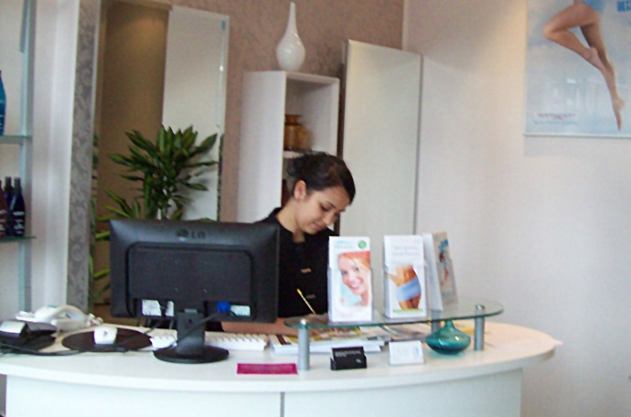
Process
Next meet reception of the salon

Slide 6

Process
Reception write your reservation service to the salon’s program.
The reception of salon give bill to your.
You give money the reception of the beauty salon.
Each customer’s total service will be evaluated by receipt.

Slide 7
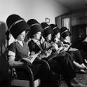










Process
Take service

Slide 8




Process
VIP member
When customer’s total bills reach 500’000₮, they will become VIP member.
VIP members can have 10% discount on each service.

Slide 9
Program description
Make reservation
Insert reservation
Delete reservation
Financial estimates
Daily report
Weekly report
Monthly report

